Slide 1
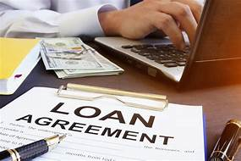

Loan Prediction Using ada-boosting with decision tree
Guided By:
SHEKHARESH BARIK
Asst. Professor, Dept. Of CSE
Presented By:
Raghunatha panda
6th Sem, CSE
1901229076
DRIEMS Autonomous Engineering College, Tangi, Cuttack

Slide 2
Contents
Introduction
Machine Learning
Ada-Boosting
Ada-Boosting Algorithm Explanation using Example
Loan prediction methodology
Complete program steps
Applications of Ada-boosting
Advantages
Disadvantages
Conclusion
References

Slide 3
Introduction
Banks, Housing Finance Companies and some NBFC deal in various types of loans like housing loan, personal loan, business loan etc
After applying loan by customer these companies validates the eligibility of customers to get the loan or not.
This project provides a solution to automate this process by employing machine learning algorithm.
This form consist details like Gender, Marital Status, Qualification, Details of Dependents, Annual Income, Amount of Loan, Credit History of Applicant and others.

Slide 4
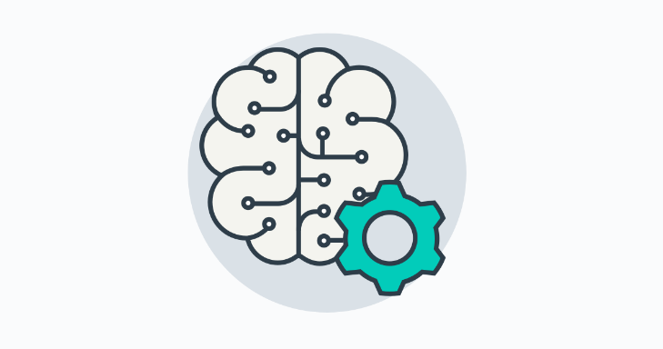
Machine Learning
Machine learning is a branch of artificial intelligence (AI).
The term machine learning was coined in 1959 by Arthur Samuel, an American
Machine learning (ML) is the study of computer algorithms that can improve automatically through experience and by the use of data.

Slide 5
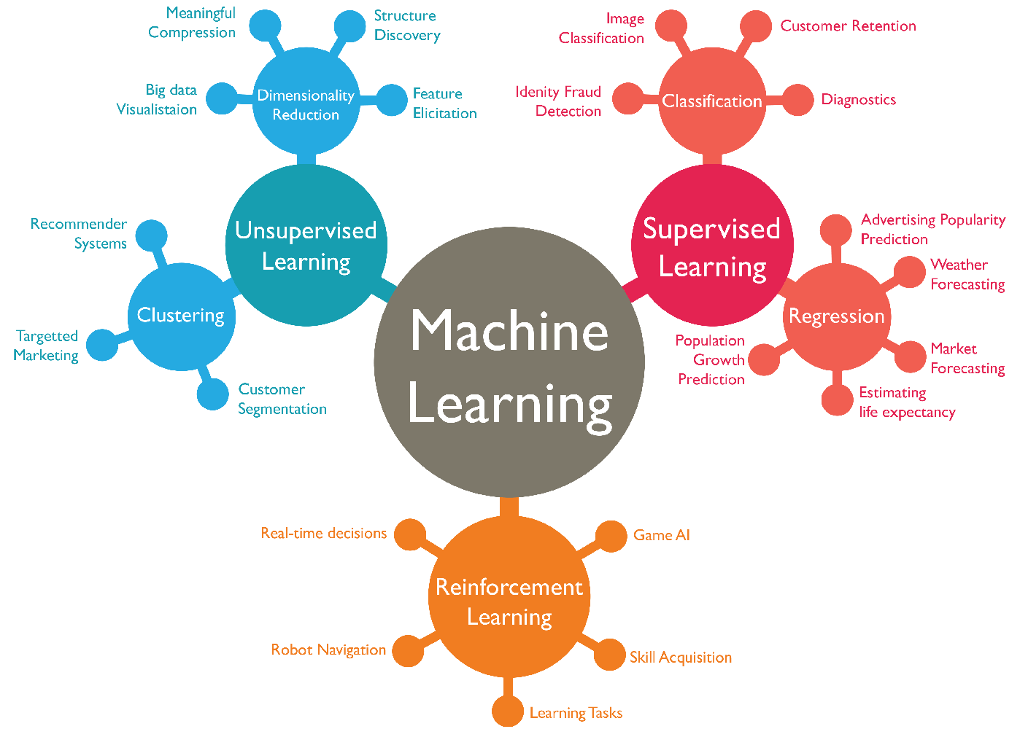

Slide 6
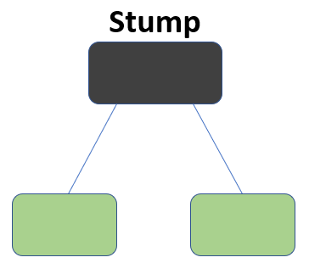
Ada-Boosting
Ada-Boosting is a technique in Machine Learning used as an Ensemble Method.
The most common algorithm used with AdaBoost is decision trees with one level that means with Decision trees with only 1 split. This is decision stump.

Slide 7
Ensemble Learning
Voting
Stacking
Bagging
Pasting
Boosting
Ensemble methods is a machine learning technique that combines several base models in order to produce one final model.
There we only understand what is adaptive boosting(Ada-Boosting technique).
Gradient boosting
Adaptive Boosting
Extreme Gradient Boosting(XGB)

Slide 8
Ada-Boosting Algorithm Explanation using an example
A
C
C
D
B
A
B
D
This is my complete data. Here, I have two class blue and red. Now the first step is to build a model to classify this data.

Slide 9
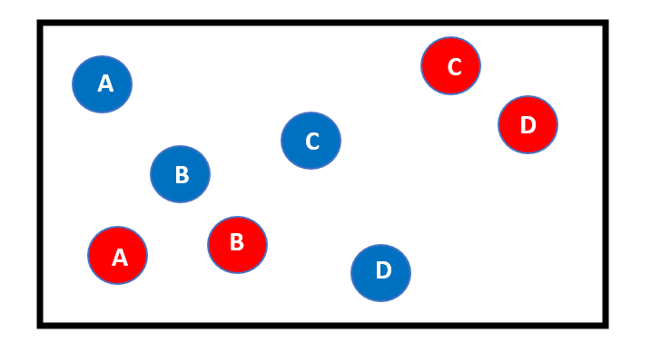
Model-1:
Suppose the 1st model gives the following result, where it is able to classify two red points on the right side(C,D). But the model also miss-classify the two red points here(A,B).
These two red points (A,B) will be given higher weights in the next iteration.

Slide 10
Model-2:
In this model we giving higher weights to previous model miss-classify points means, my model is going to focus more on these points(A,B).
In the 2nd model gives the above result, where it is able to classify two red points (A,B) which are miss-classify in previous model. But the model also miss-classify one blue point(D).
So, this one blue point(D) will be given higher weights in the next iteration.

Slide 11
Model-3:
In this model we giving higher weights to previous model miss-classify points means, my model is going to focus more on these points(D).
In the 3rd model gives the above result, where it is able to classify one blue points (D) which are miss-classify in previous model.

Slide 12
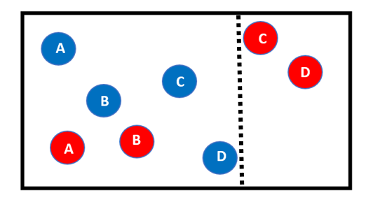
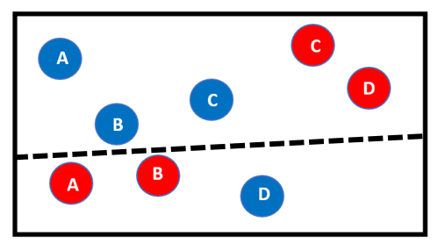
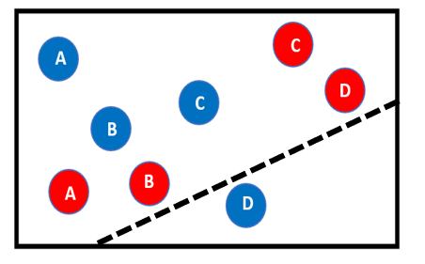
we can say all these individual models are not strong enough to classify the points correctly and are often called weak learners.
After multiple iterations, we will be able to create the right decision boundary with the help of all the previous weak learners.
As you can see the final model is able to classify all the points correctly.
This final model is known as a strong learner.

Slide 13
Steps For Ada-boost Algorithm
Step-1:Initialize the weights as 1/n to every n observations.
Step-2: Select the features according to highest information gain and calculate the total error.
Step-3:Calculate the performance of the stump.
Step-4:Calculate the new weights for each miss-classification (increase) and right classification(decrease).
Step-5: Normalize the new weights so that the sum of weights is 1.
Step-6: Now repeat from step-2

Slide 14
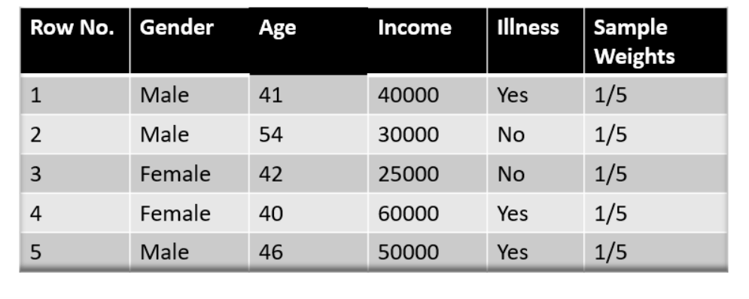
Understanding the working of AdaBoost Algorithm
The Image is shown below is the actual representation of a loan dataset.
Row No: no of observation we take
Gender: male/female
Age: what is the client age
Income: the income amount per month
Illness(it is the target): eligible for loan or not(yes/no)

Slide 15
Step-1:Initialize the weights as 1/n to every n observations.
Here ,n=5
so, 1/n=1/5=0.2
Row No | Gender | Age | Income | Target | weights
1 | Male | 41 | 40000 | Yes | 0.2
2 | Male | 54 | 30000 | No | 0.2
3 | Female | 42 | 25000 | No | 0.2
4 | Female | 40 | 60000 | Yes | 0.2
5 | male | 46 | 50000 | yes | 0.2
Initially, all the weights will be equal.
The sum of all weight =1

Slide 16
Step-2: Select the features according to highest information gain and calculate the total error.
Row No | Gender | Age | Income | Target | weights
1 | Male | 41 | 40000 | Yes | 0.2
2 | Male | 54 | 30000 | No | 0.2
3 | Female | 42 | 25000 | No | 0.2
4 | Female | 40 | 60000 | Yes | 0.2
5 | male | 46 | 50000 | yes | 0.2
AGE
age<=40
age>40
yes
no
Here, in case observation 2,3,4 have miss-classified.
Here ,out of 5 ,three have miss-classified and two have right classified.
Total error =miss-classified/n
= 3/5
= 0.6

Slide 17
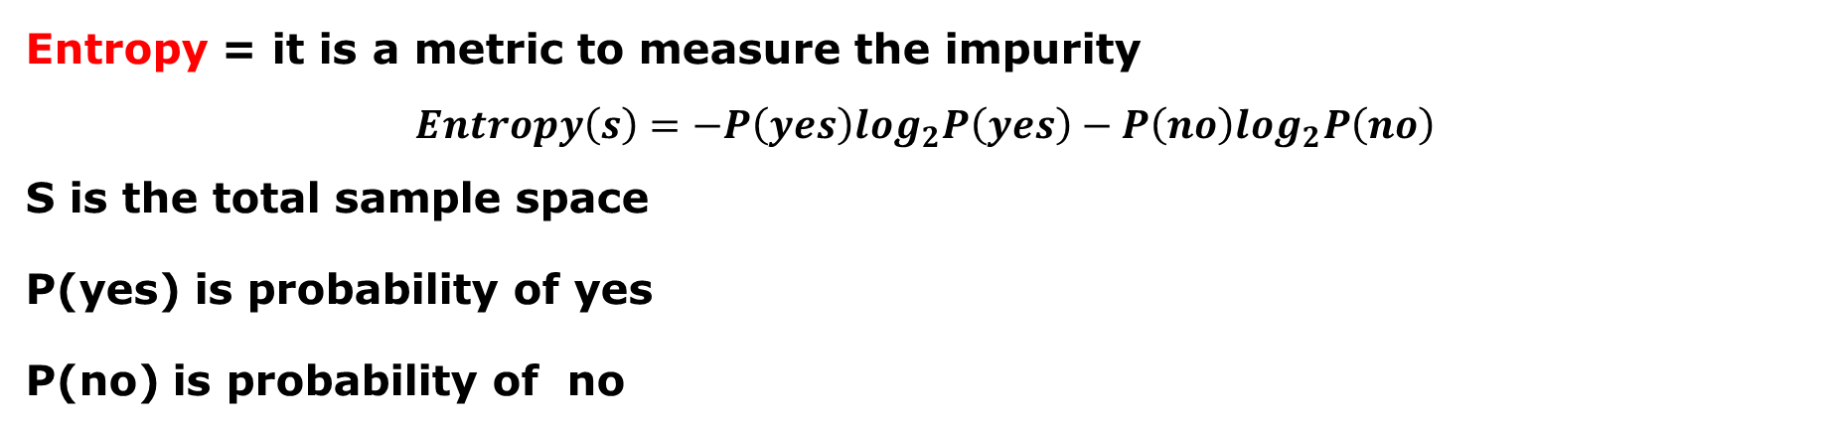
Information gain
IG(s,a) =H(s)-H(s|a)
H(s) = entropy for the dataset before any change
IG =information for the dataset S for the variable a for a random variable
H(s|a)= conditional entropy for the dataset given
Entropy = it is a metric to measure the impurity
$$Entropy\left(s\right)=−P\left(yes\right)\log_{2}P\left(yes\right)−P\left(no\right)\log_{2}P\left(no\right)$$
S is the total sample space
P(yes) is probability of yes
P(no) is probability of no

Slide 18

Step-3:Calculate the performance of the stump.
Row No | Gender | Age | Income | Target | weights
1 | Male | 41 | 40000 | Yes | 0.2
2 | Male | 54 | 30000 | No | 0.2
3 | Female | 42 | 25000 | No | 0.2
4 | Female | 40 | 60000 | Yes | 0.2
5 | male | 46 | 50000 | yes | 0.2
performance of the stump=
=1/2 x loge(1-0.6)/0.6
=1/2 x loge(0.6)
=1/2 x 0.5
=0.25

Slide 19
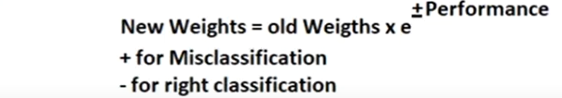
Step-4:Calculate the new weights for each miss-classification (increase) and right classification(decrease).
Updating Weights:
+0.25
New weight = 0.2x e =0.2 X 1.28=0.25
-0.25
New weight = 0.2 x e =0.2 X 0.77=0.15

Slide 20
Row No | Gender | Age | Income | Target | weights | Update weights
1 | Male | 41 | 40000 | Yes | 0.2 | 0.15
2 | Male | 54 | 30000 | No | 0.2 | 0.25
3 | Female | 42 | 25000 | No | 0.2 | 0.25
4 | Female | 40 | 60000 | Yes | 0.2 | 0.25
5 | male | 46 | 50000 | yes | 0.2 | 0.15
Step-5: Normalize the new weights so that the sum of weights is 1.
Row No | Gender | Age | Income | Target | weights | u. weights | Normalized weights
1 | Male | 41 | 40000 | Yes | 0.2 | 0.15 | 0.15/1.05=0.14
2 | Male | 54 | 30000 | No | 0.2 | 0.25 | 0.25/1.05=0.23
3 | Female | 42 | 25000 | No | 0.2 | 0.25 | 0.25/1.05=0.23
4 | Female | 40 | 60000 | Yes | 0.2 | 0.25 | 0.25/1.05=0.23
5 | male | 46 | 50000 | yes | 0.2 | 0.15 | 0.15/1.05=0.14
 |  |  |  |  | 1 | 1.05 | 1
Step-6: Now repeat from step-2 and so on till the configured number of estimators reached(no. of defined model) or the accuracy achieved(error free).

Slide 21
Loan Prediction Methodology:
Collection of data set
Feature selection using info gain of features
Train model on training data set
Test the model on testing data set
Result analysis

Slide 22
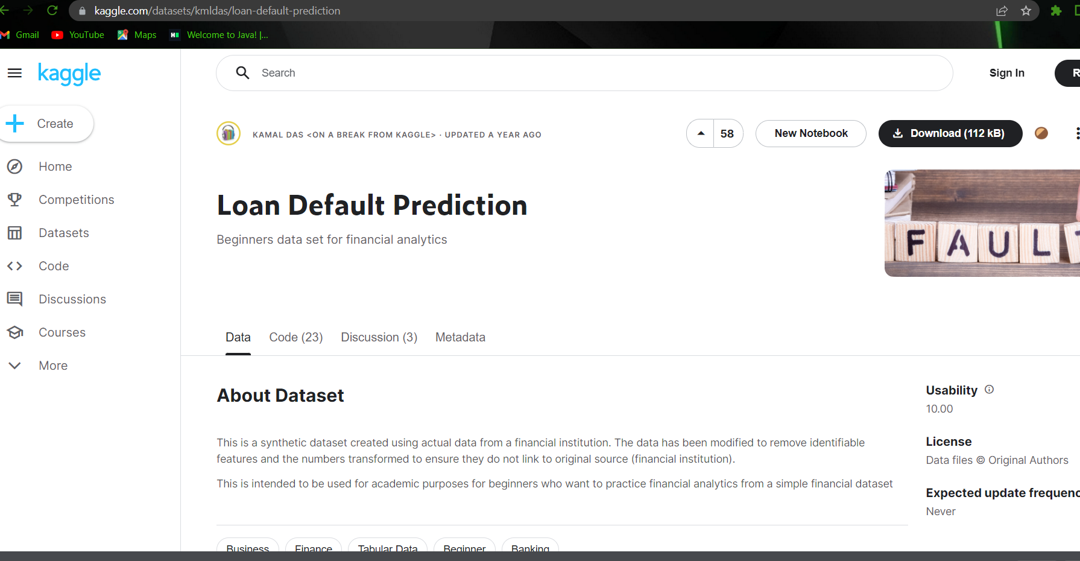
Complete program steps:
Step 1: Download the Loanprediction.csv Dataset from Here
https://www.kaggle.com/datasets/kmldas/loan-default-prediction/download

Slide 23
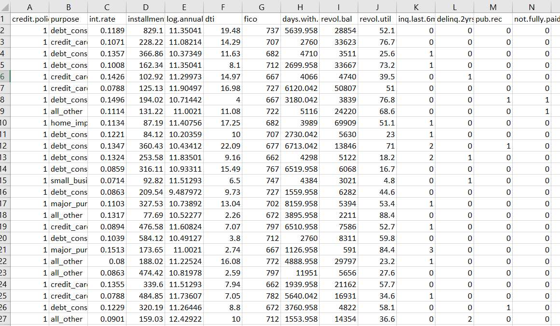
View of Dataset in Excel

Slide 24
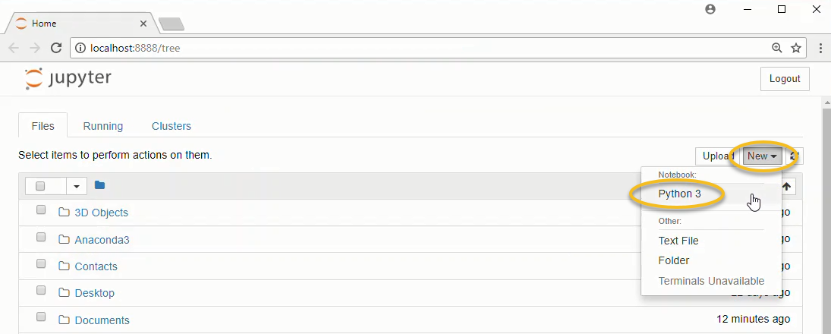
Step 2: Open the Jyupter Notebook and create a new Notebook

Slide 25
Dataset Attributes
credit.policy :1 if the customer meets the credit underwriting criteria of LendingClub.com, and 0 otherwise.
purpose :The purpose of the loan (takes values “credit_card”, “debt_consolidation”, “educational”, “major_purchase”, “small_business”, and “all_other”).
int.rate: The interest rate of the loan, as a proportion (a rate of 11% would be stored as 0.11). Borrowers judged by LendingClub.com to be more risky are assigned higher interest rates.
Installment:The monthly installments ($) owed by the borrower if the loan is funded.
log.annual.inc : The natural log of the self-reported annual income of the borrower.
dti : The debt-to-income ratio of the borrower (amount of debt divided by annual income).
fico : The FICO credit score of the borrower. days.with.cr.line: The number of days the borrower has had a credit line.

Slide 26
revol.bal : The borrower’s revolving balance (amount unpaid at the end of the credit card billing cycle).
revolute :The borrower’s revolving line utilization rate (the amount of the credit line used relative to total credit available).
inq.last.6mths :The borrower’s number of inquiries by creditors in the last 6 months.
delinq.2yrs : The number of times the borrower had been 30+ days past due on a payment in the past 2 years.
pub.rec : The borrower’s number of derogatory public records (bankruptcy filings, tax liens, or judgments).

Slide 27
Step 3: Import all required Libraries and load loanprediction.csv dataset.
Step 4: Perform Data Exploration on the Dataset
Step 5: Data Visualization
Step 6: Feature Selection
Step 7: Data Preprocessing

Slide 28
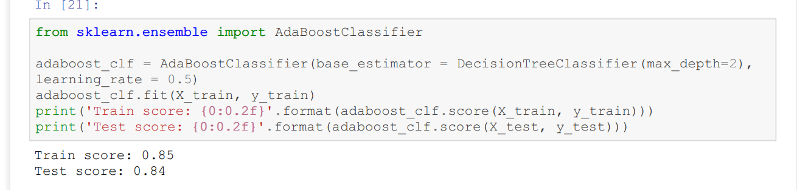
Step 8: model building
It giving the same result of 84% .

Slide 29
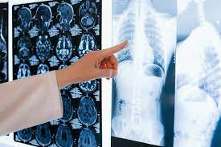
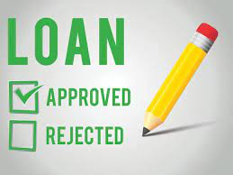
Applications of Ada-boosting
Diagnosis disease
Loan Prediction

Slide 30
Advantages
AdaBoost has many advantages due to its ease of use and less parameter.
The accuracy of weak classifiers can be improved by using Ada-boost.
Quick calculation time

Slide 31
Disadvantages
High-quality data is needed in examples of AdaBoost
Noise in data requiring the elimination of these factors before using the data.
It is high accuracy for small dataset

Slide 32
Conclusion
Ada-boosting with decision tree in our case gives 84% accuracy.
Here we saw, how can we ensemble multiple weak learners to get a strong classifier.
We also saw the implementation in python of the same.

Slide 33
References
Ashwini S. Kadam, Shraddha R Nikam, Ankita A. Aher, Gayatri V. Shelke, Amar S. Chandgude. “Prediction for Loan Approval using Machine Learning Algorithm”, Apr 2021 International Research Journal of Engineering and Technology (IRJET)
Mohammad Ahmad Sheikh, Amit Kumar Goel,Tapas Kumar. "An Approach for Prediction of Loan Approval using Machine Learning Algorithm", 2020 International Conference on Electronics and Sustainable Communication Systems (ICESC), 2020
X.FrencisJensy, V.P.Sumathi,Janani Shiva Shri, “An exploratory Data Analysis for Loan Predict ion based on nature of clients”, International Journal of Recent Technology and Engineering (IJRTE),Volume-7 Issue-4S, November 2018

Slide 34



